Slide 1
VFS Mortgages
Omiga Technology Refresh
^{14th} September 2007

Slide 2
Agenda
Current Omiga Architecture Overview
Drivers for change
End State Architecture
Phased Approach
Buy / reuse vs build
Next steps and Questions

Slide 3
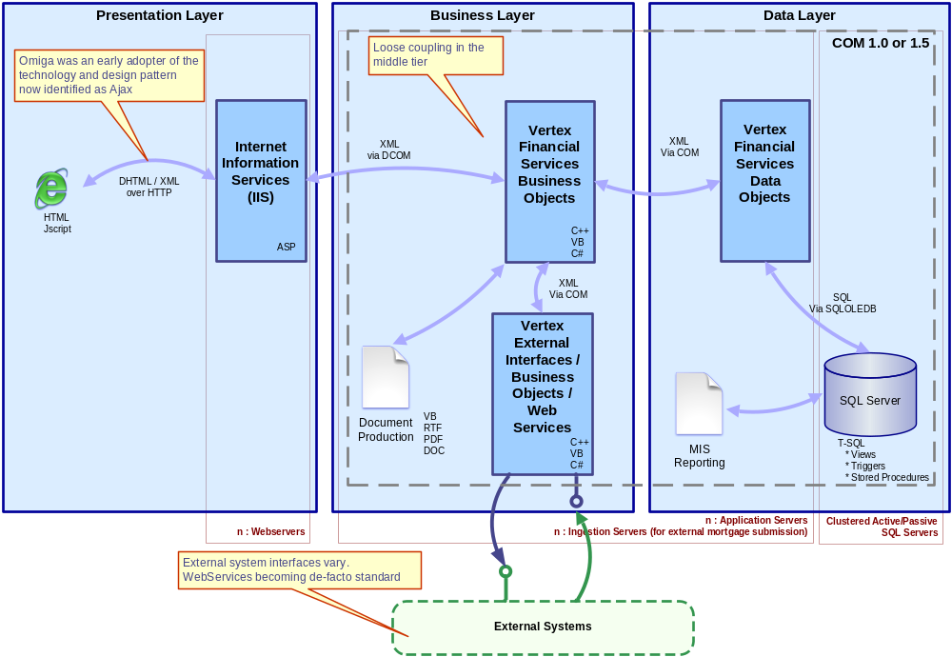
Current Architecture – high level overview
Notes:
Classic Windows DNA

Slide 4
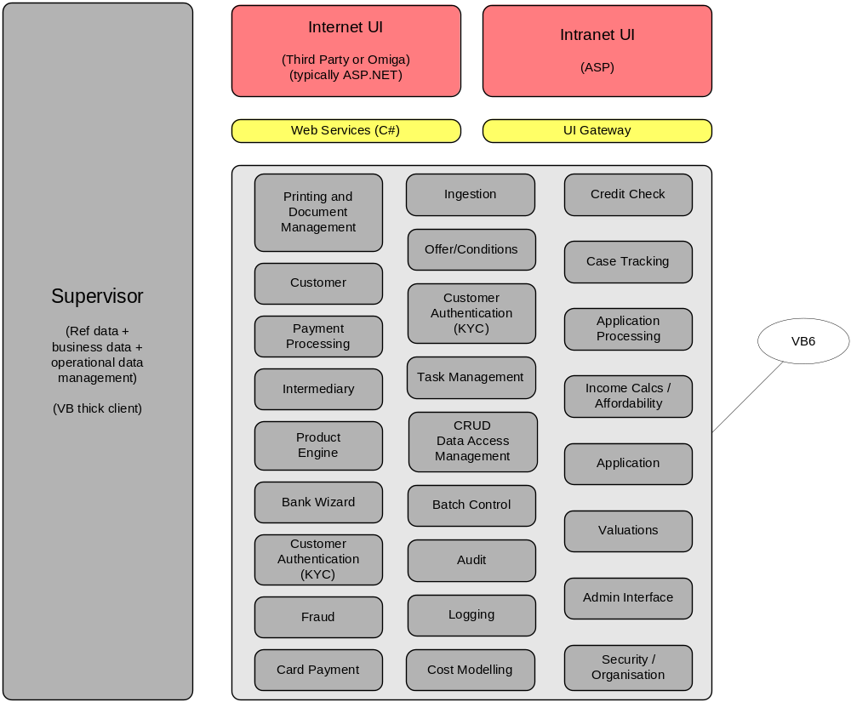
Current Architecture – representation of Omiga components

Slide 5
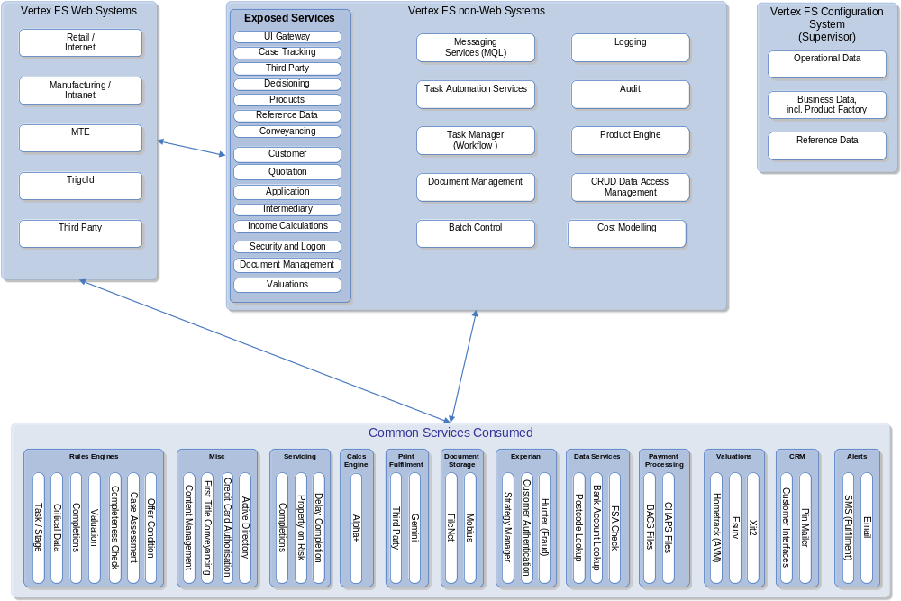
Current Architecture – enterprise application integration
Notes:
Exposing Sub-set of functionality via web services
Consuming services
All XML based comms

Slide 6
Drivers for Change
VB6 out of extended support April 2008
Sales lost due to non-supported platform
Cost and speed of delivery
Move to product based solutions
Move to component based ‘plug and play’ solutions (SOA)
Resuable ‘enterprise’ services
Added value services offer differentiators
Notes:
VB6 out of extended support April 2008
Need to offer roadmap for existing customers
.Net technology is now a ‘killer question’ on most responses
Sales lost due to non-supported platforms – key feedback from Nationwide – will not deploy code out of support
Risk to bids of non-supported platform
Competitors using latest technology
Move to product based solutions
Cheaper to produce and maintain
Quicker to market

Slide 7
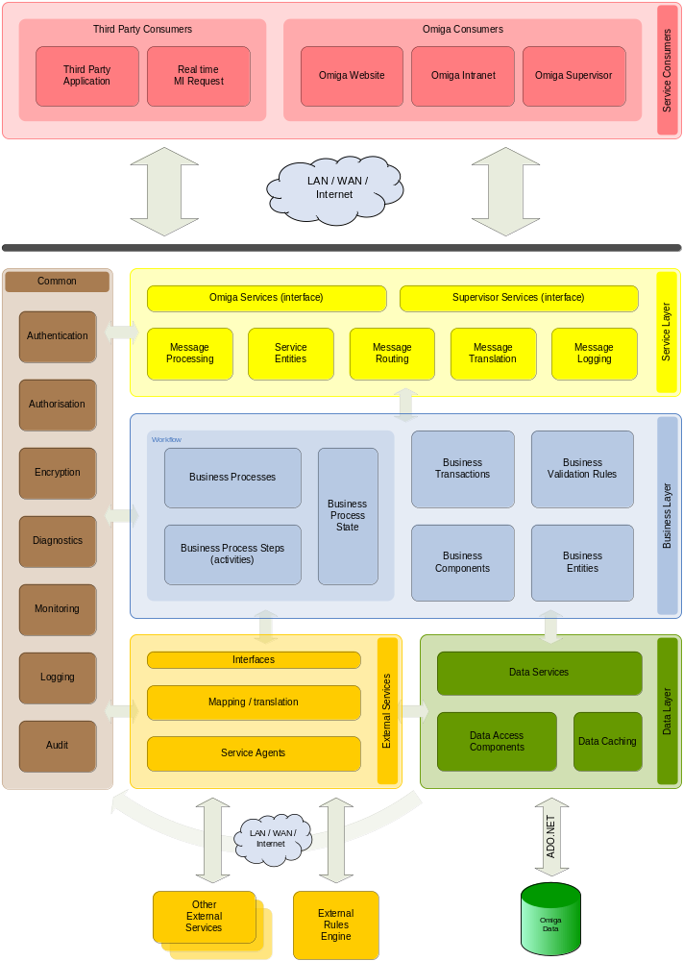
End State Architecture – high level overview
Notes:
Service Oriented Architecture (SOA)
Adherence to standards, principles and best practice in the market - standard tools and methods
Omiga as a collection of services and sub-systems implemented as loosely coupled components
Provides Omiga functionality via services
Consumes external and/or existing enterprise services
Omiga services to be consumed by Omiga UIs, external systems and 3rd party UIs
Emphasis on reuse of existing components available with the group

Slide 8
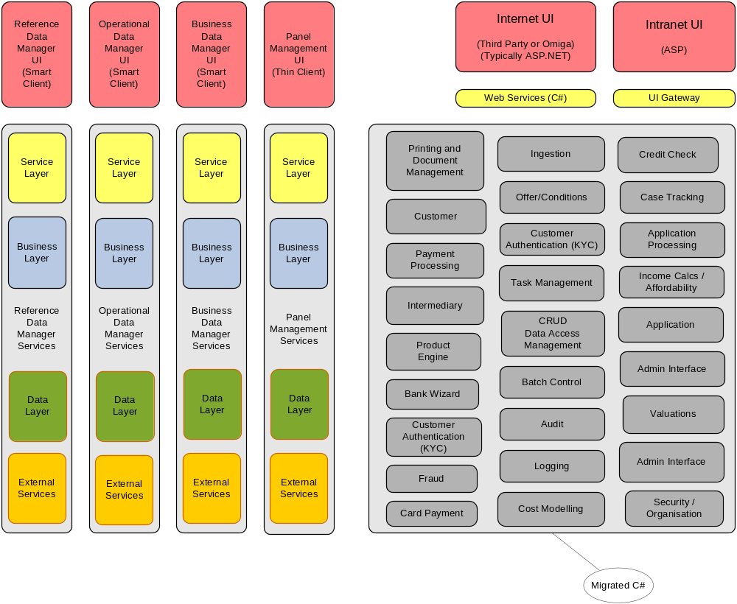
Phased Approach – Phase 1: Re-architected Supervisor
Migrated Omiga, ASP.Net UI
Notes:
Migration of code right-shored by engaging Artinsoft
Rewritten functionality to be developed in line with end state direction
Majority of Supervisor services likely to be exposed by UI built on FNET framework – shared infrastructure
Fast to market due to incremental approach

Slide 9
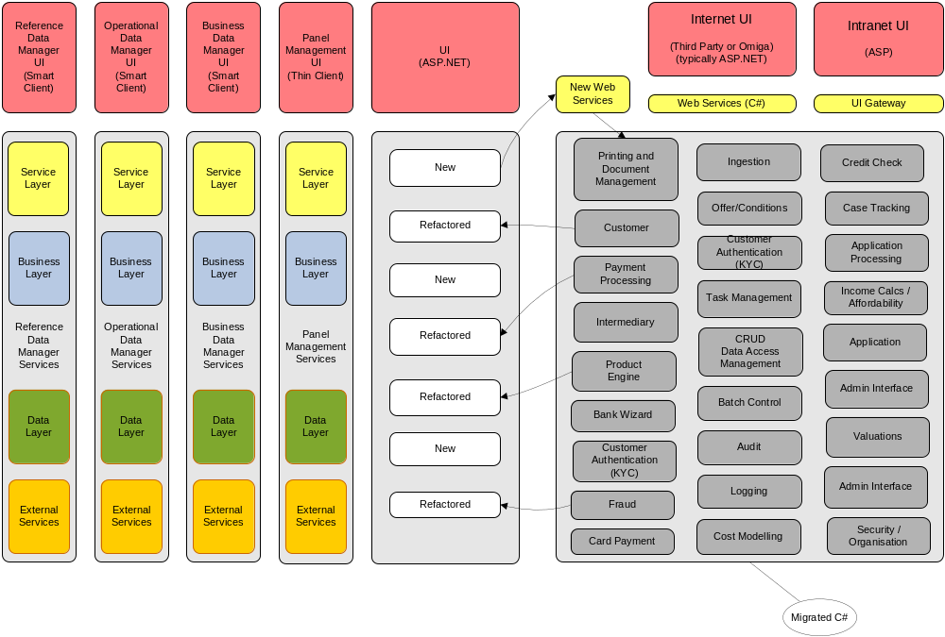
Phased Approach – Phases 2 +
Funded continuous re-architecting to end-state
Notes:
Re-factoring of existing components wherever appropriate
Reuse of existing components via web service façade where appropriate
Incremental addition of SOA services

Slide 10
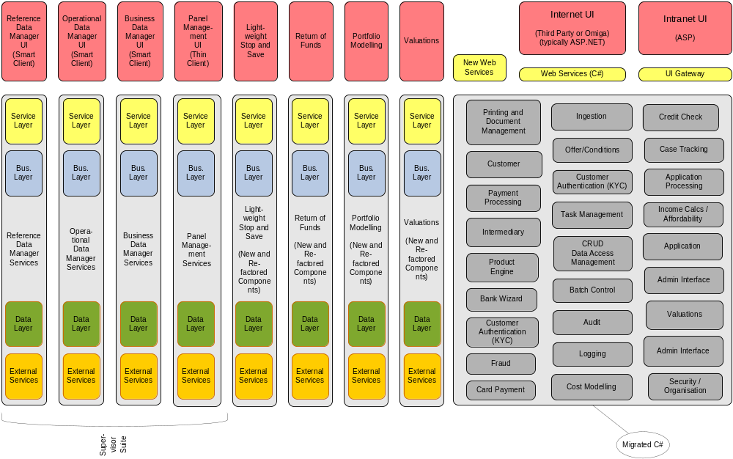
Phased Approach – Phases 2 +
Project Palmer
Notes:
Business-led continual progress towards end state
Further incremental addition of SOA services

Slide 11
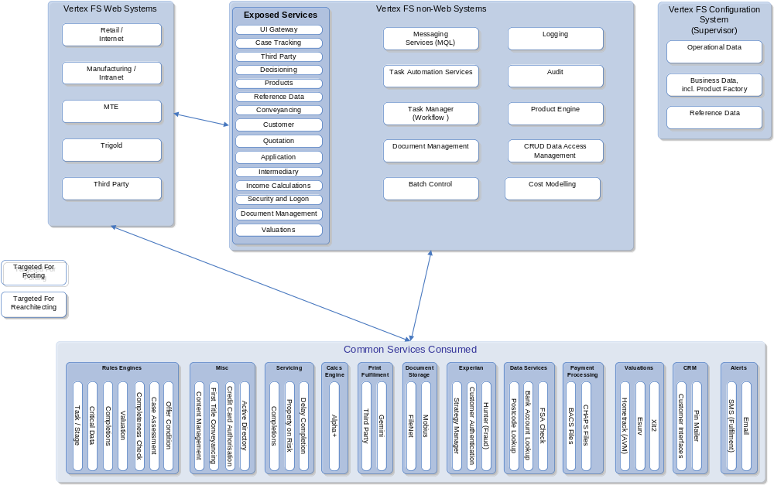
Phased Approach – Phases 2 +
Candidates for service consumption vs build
Notes:
Subset of components and services already identified as best suited to re-architecting via mixture of
Replacing with services available within the group
Replacing with services available from third party suppliers
Rebuilding in a manner suitable for use across the group (reusable components)
Some common services consumed are already interchangeable (e.g. document storage type) or agnostic of external service (e.g. interfaces to servicing and CRM systems)

Slide 12
Questions ?
Next Steps ?

